Slide 1
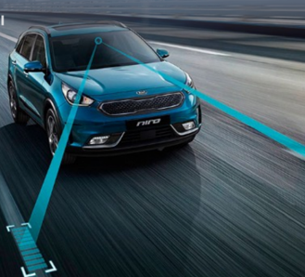
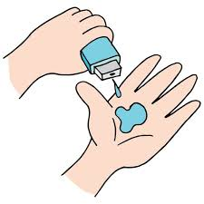
VOIS_Camp_Team N0.22
Road Lane Detection for Autonomous Cars
Presented by -
Tanish Modase
Tushar Muley
Tanay Patel
Camp Mentor: Deepika Singh Ma’am

Slide 2

PROJECT TITLE
Road Lane Detection for Autonomous Cars
DOMAIN
Computer Vision

Slide 3
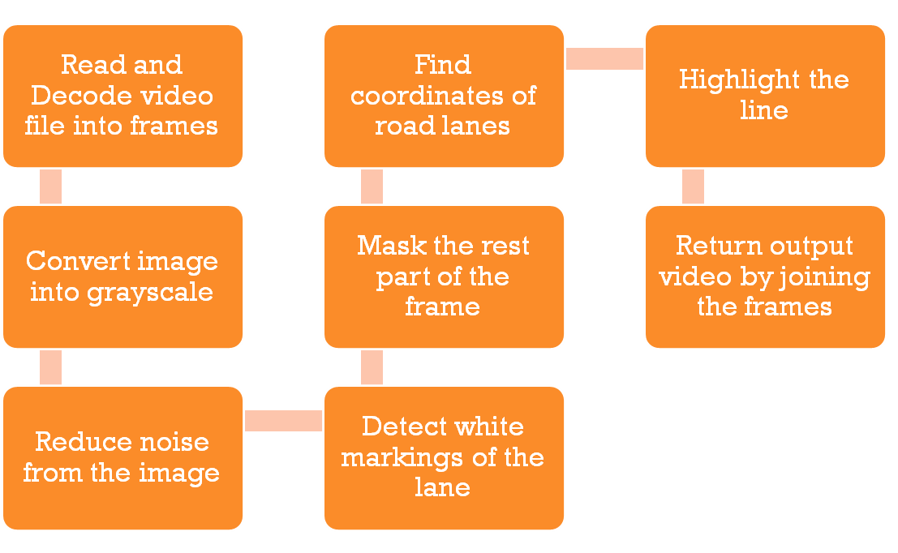

AGENDA

Slide 4

PROBLEM STATEMENT
Increasing safety, reducing road accidents and enhancing comfort and driving experience are the major motivations behind Automated cars. To fulfill this criteria, computer vision techniques are used which are capable of sensing the surrounding environment for detection of road lanes.

Slide 5

PROJECT OVERVIEW
Lane Line detection is a critical component for self driving cars and also for computer vision in general.
Using computer vision techniques in Python, we will identify road lane lines in which autonomous cars must run. This will be a critical part of autonomous cars, as the self-driving cars should not cross it’s lane and should not go in opposite lane to avoid accidents.

Slide 6

WHO ARE THE END USERS?
The proposed technique is well suited to be used by Advanced Driving Assistance Systems(ADAS) or self-driving cars.

Slide 7

YOUR SOLUTION AND ITS VALUE PROPOSITION
The proposed technique detects a single lane boundary set for autonomous vehicles from an input video feed. It also tracks car positions relative to lanes, departure, entry etc. The technique is feasible and works with a high recognition rate.

Slide 8

THE WOW IN YOUR SOLUTION
The proposed system is put to the test with a variety of inputs and weather conditions. In addition to input video, real time video feed can be utilised to evaluate the system.

Slide 9

MODELLING
Tools used in the system are:
Tkinter
Computer Vision (OpenCV)
MoviePy
Gray Scaling
Canny Edge Detection
Hough Transform
Python

Slide 10
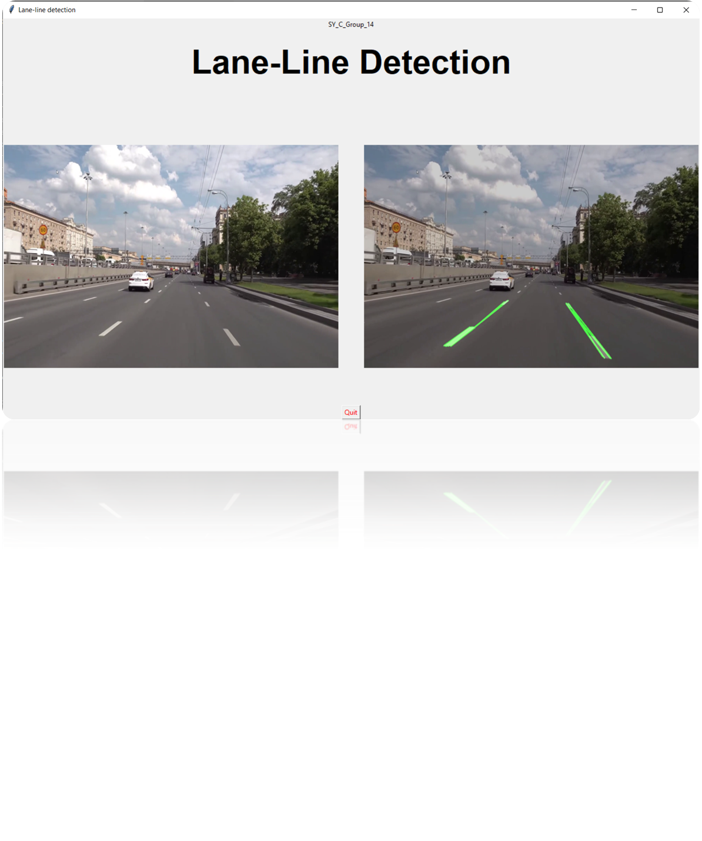
MODELLING
Tkinter

Slide 11
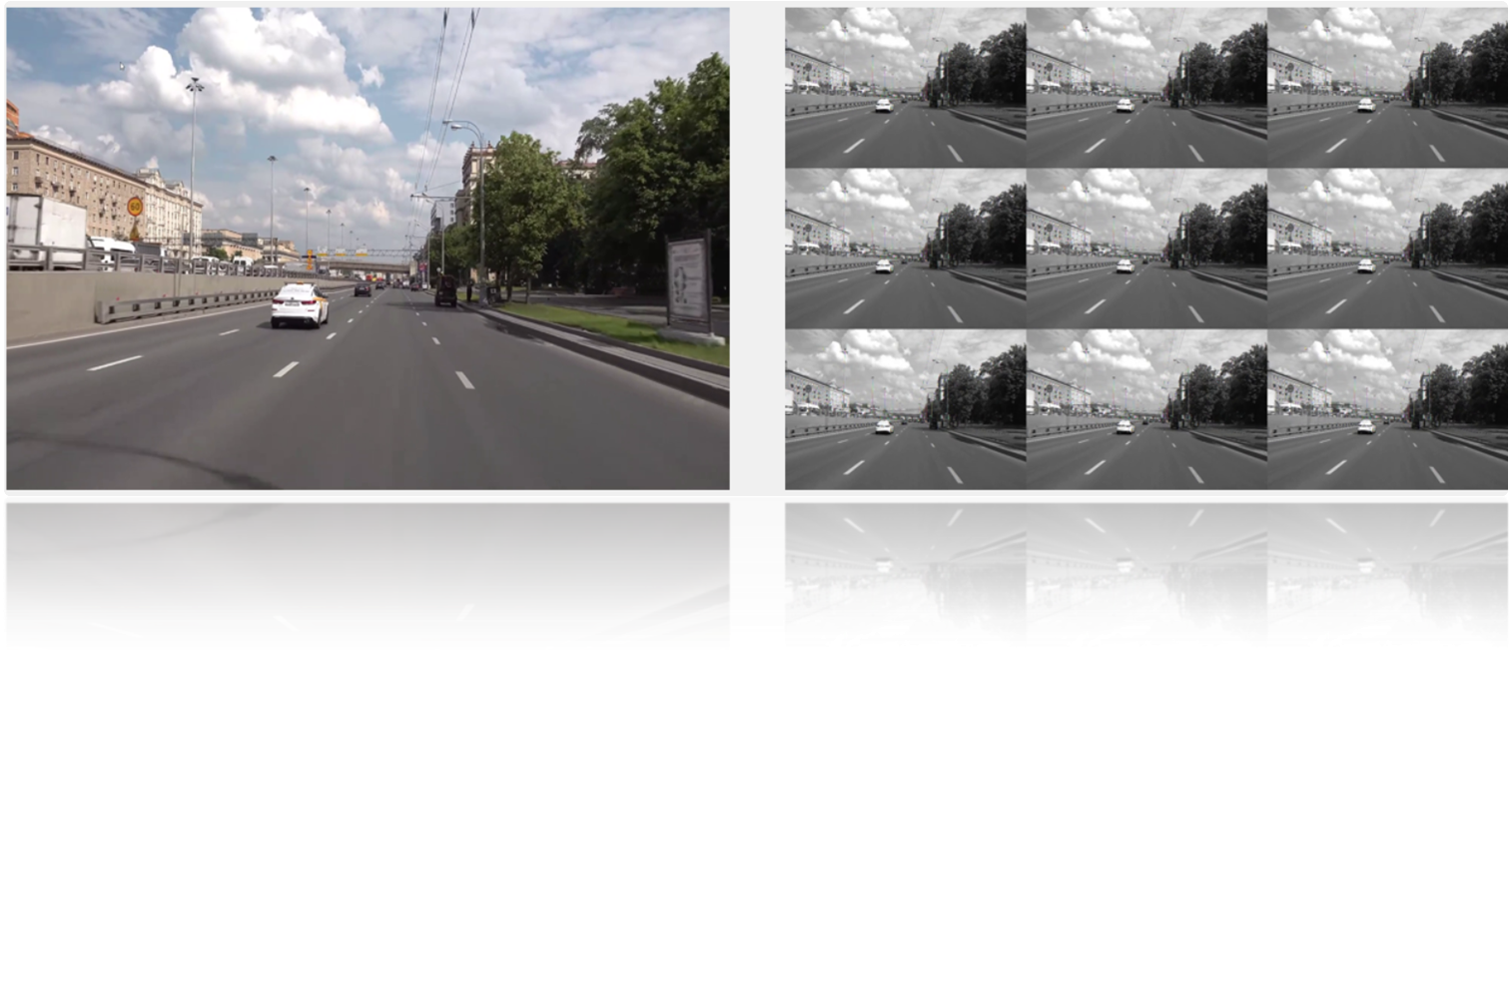
MODELLING
Image Processing
Grayscale Conversion of Image
Reduce Noise

Slide 12
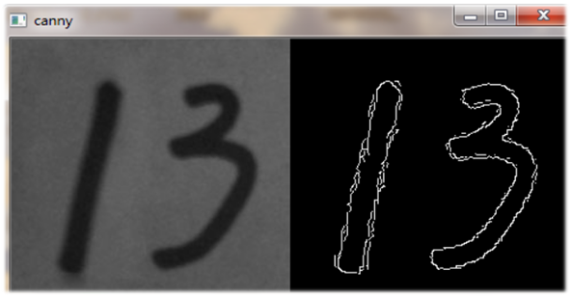
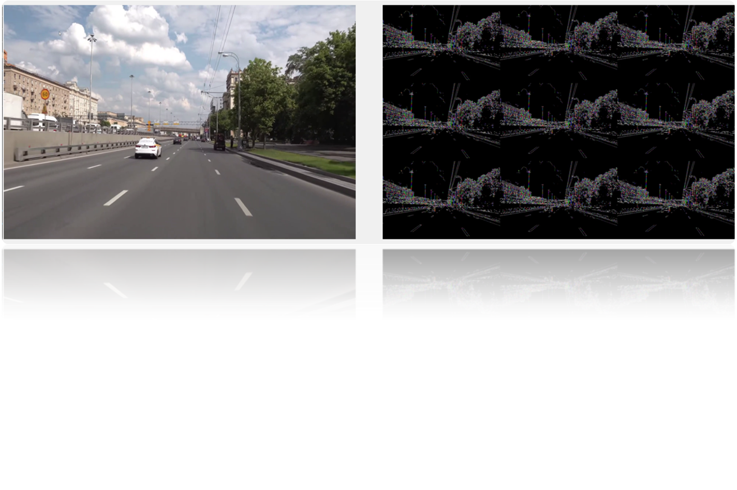
MODELLING
Canny Edge Detection

Slide 13
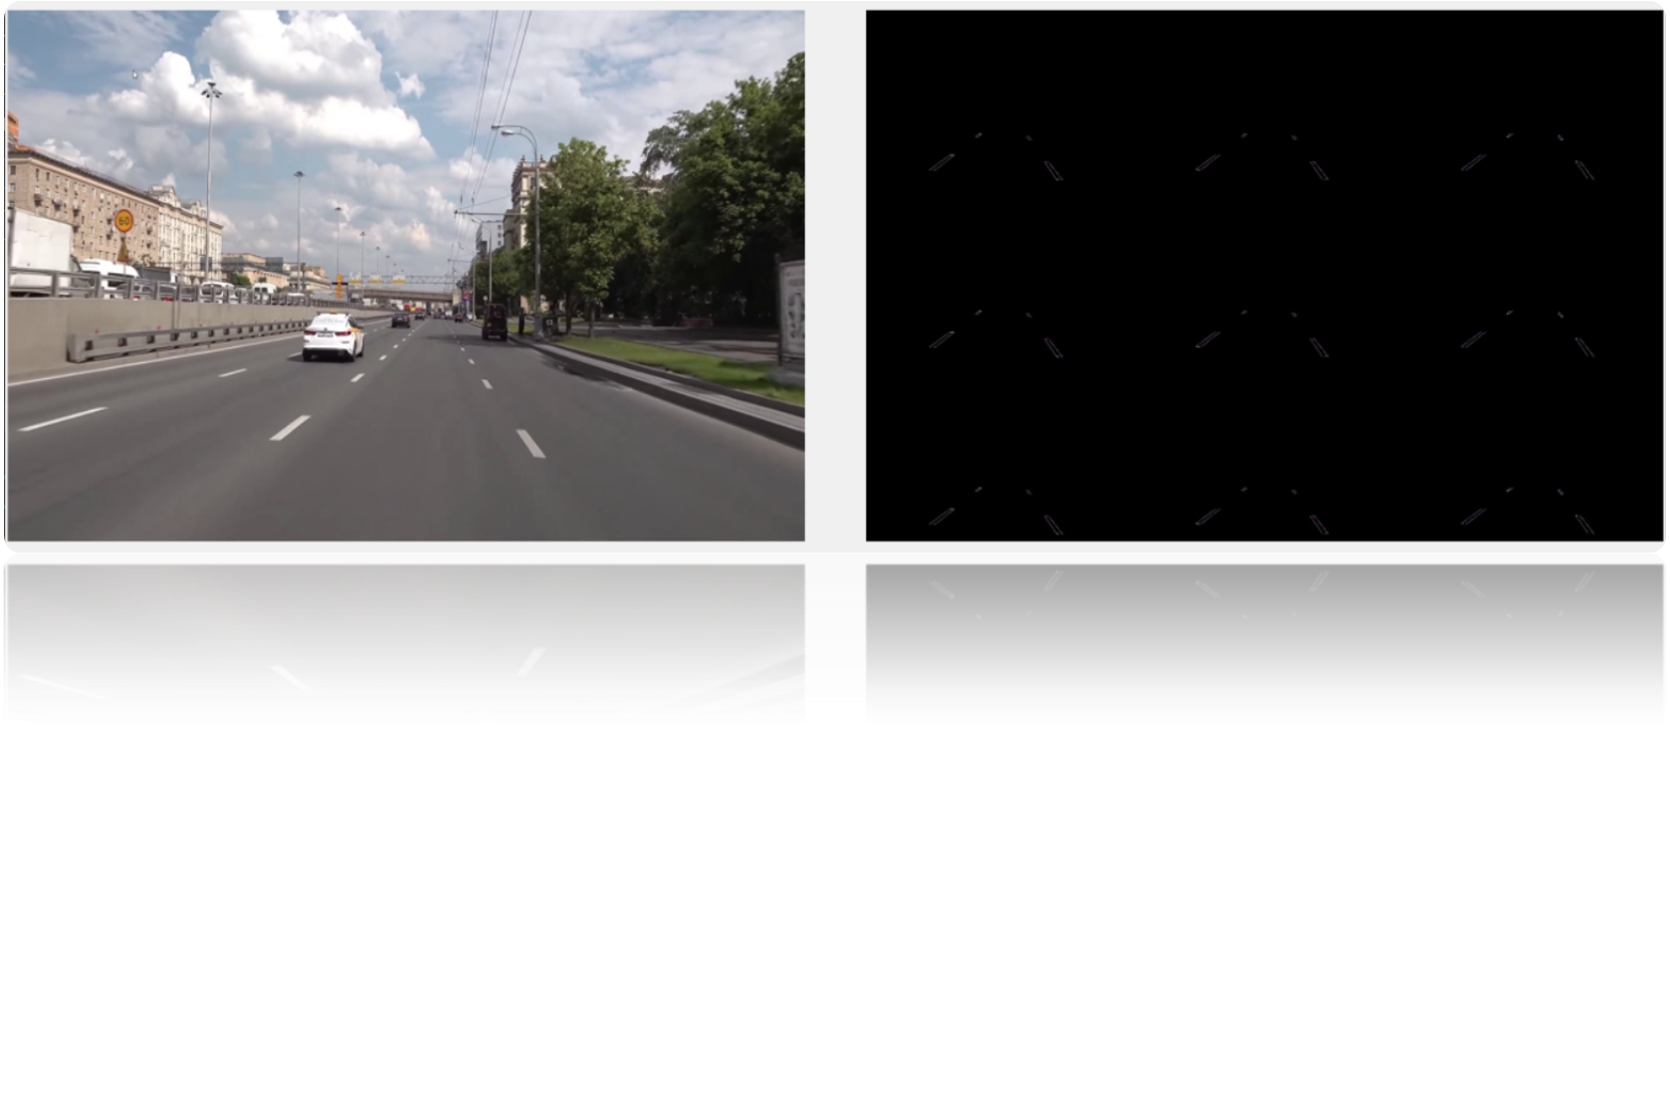
MODELLING
Frame Masking

Slide 14
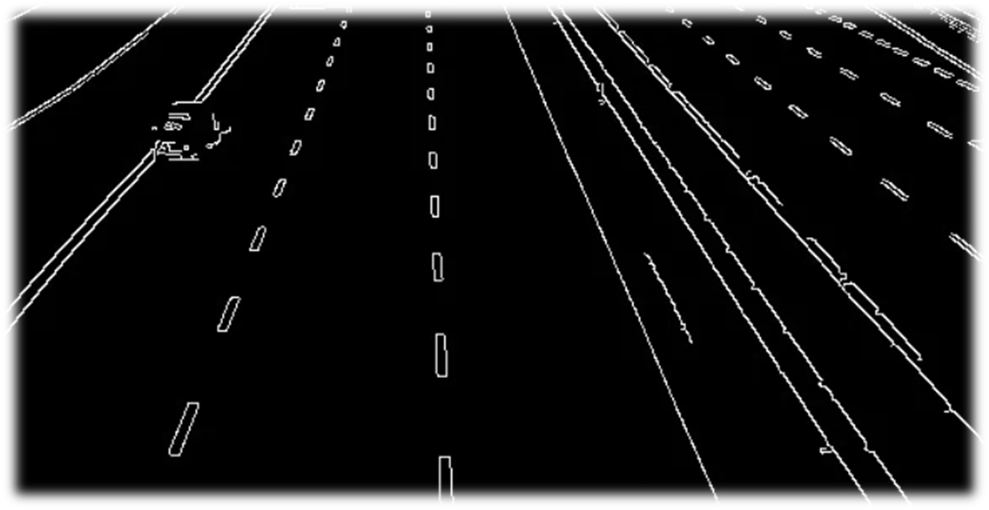

MODELLING
Hough Transform

Slide 15

RESULTS
https://github.com/tanishmodase18/Road-Lane-Detection

Slide 16
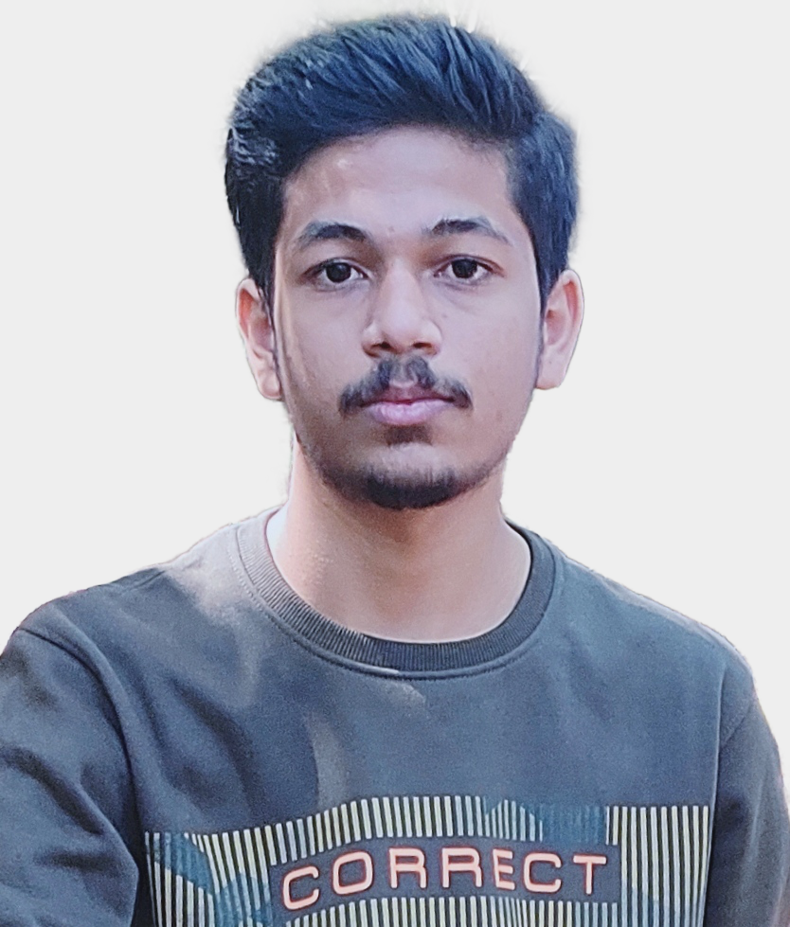
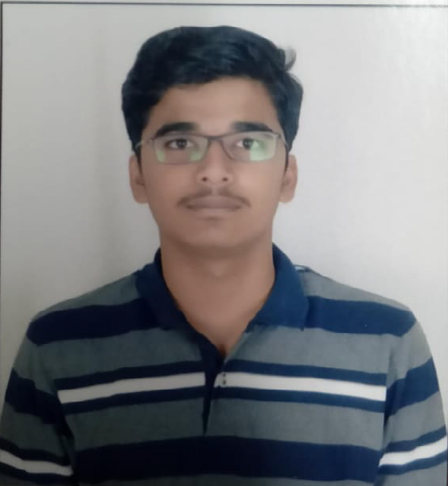
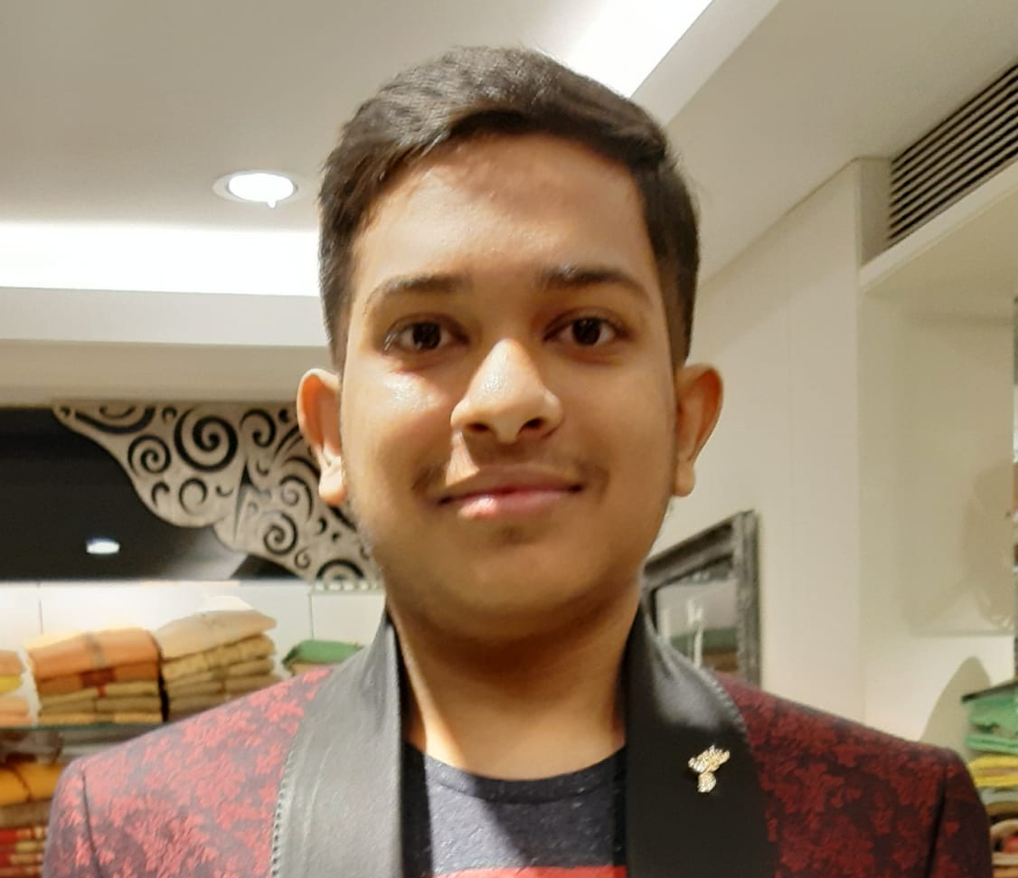
MEET OUR TEAM
Tanish Modase
Tushar Muley
Tanay Patel
VOIS_Camp_Team N0.22

Slide 17

CREDITS
Stakeholders | Subject Matter Experts(SMEs) | Coaches

Slide 18
THANK YOU

